Slide 1

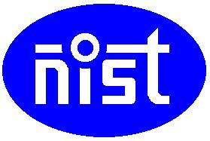
POLYTRONICS
By
Student Name : Navneet Nipu Roll No: ECE#201710518
BPUT Regn . No:1701202158
Under the guidance of
Prof. Santosh Kumar Patnaik
Notes:
B-TECH PROJECT MID-SEM PRESENTATION 2011
BY KHUSHBU KHAN & ISAN SAHOO

Slide 2
Contents
What is polymer electronics?
What makes polymer so suitable for electronics application?
Electric conductor polymer types
Intrinsically conductive polymer
Two conditions to become conductive
ICP material
Properties of ICP
ICP as a matrix polymer

Slide 3
Contents
Electrical properties of ICP based nanocomposites
Application
Printed electronics
Printed electronics methods
Structure of OTFT
Application of organic TFT
Advantages v/s disadvantages of polymer electronics
Conclusions
References

Slide 4
What is polymer electronics?
Polymers are long-chain molecules consisting of many repeat units to make a solid material.
Polymers are normally electrical insulators, but to enable their use in electronics, conductive filler such as silver have been added to chemical formulation to increase their electrical conductivity.
The merits in this research area, the Nobel Prize 2000 for Chemistry was awarded to Alan J. Heeger, Alan G. MacDiarmid and Hideki Shirakawa.

Slide 5
What is polymer electronics?
Involves the usage of electrically conducting polymer or plastics in making electronic circuits .
The ‘PLASTIC CIRCUITS’ is one alternative that would meet the future technological needs.
Polytronics have some advantages over the current silicon technology which is mainly used in electronics.

Slide 6
What makes polymer so suitable for electronics application?
Good insulator of heat
Can form any shape.
They have low density.
They require low finishing cost.
Their toughness and ductility is good.
Enhanced flexibility allowed for many application Solubility.i.n organic solvents, variable processibility.

Slide 7
Electric conductor polymer types
Depending on the type of charge transport by the carriers responsible for it
Ionically conductive polymer:
It is used as a solid-state electrolyte in batteries.
Eg: poly ethylene oxide which contain lithium perchlorate(LiClO4).
Electronically conductive:
Filled conductive polymers
Intrinsically conductive polymers

Slide 8
Intrinsically conductive polymer
They do not incorporate any conductive additives.
They gain their electrical Conductivity through a property known as ‘conjugation’.
Conjugated polymers are doped with atoms that donate negative or positive charges enabling current to travel down the polymer chain.

Slide 9

Two conditions to become conductive
The first condition is the polymer consists of alternating single and double bonds, called conjugated double bonds.
In conjugation, the bonds between the carbon atoms are alternately single and double. Every bond contains a localised “sigma” (σ) bond which forms a strong chemical bond. In addition, every double bond also contains a less strongly localised “pi” (π) bond which is weaker.
Figure 1: Conjugated double bond

Slide 10
Two conditions to become conductive
The second condition is the plastic has to be disturbed - either by removing electrons from (oxidation), or inserting them into (reduction), the material. The process is known as Doping.
There are two types of doping:
Oxidation with halogen (or p-doping).
Reduction with alkali metal (called n-doping).

Slide 11
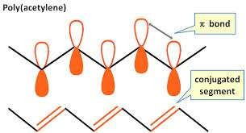
ICP material
Polyaniline
Polythiophene
Polypyrrole
Polyacetylene
Figure 2: Polyacetylene

Slide 12
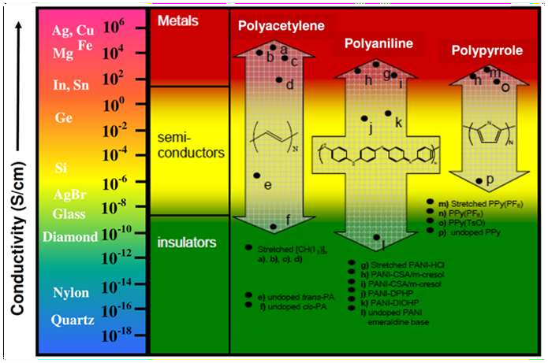
Properties of ICP
Electrical conductivity
Ability to store an electric charge
Ability to exchange ions
Figure 3:electrical conductivity of ICP materials

Slide 13
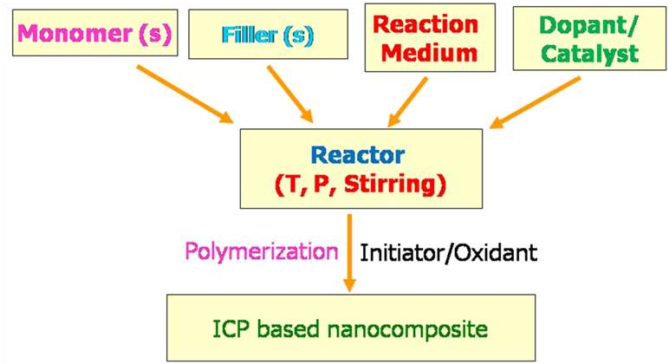
ICP as a matrix polymer
It provide design flexibility, good filler incorporation ability, specific interactions with fillers and microwave non-transparency.
Figure 4:ICP as a matrix polymer

Slide 14
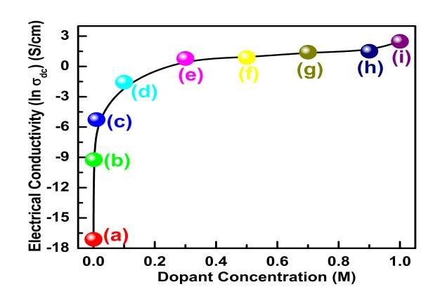
Electrical properties of ICP based nanocomposites
Variation of electrical conductivity (ln σdc) of hydrochloric acid (HCl) doped Emeraldine
base (EB) samples as a function of dopant (HCl) concentration (a) 0.0 M (b) 0.001 M, (c) 0.01 M, (d) 0.1M, (e) 0.3 M, (f) 0.5 M, (g) 0.7 M, (h) 0.9 M and (i) 1.0 M
Figure 5:

Slide 15
Printed electronics
It is a set printing create electrical devices on various substrate .
Printed electronics, specifies the process and subject to the specific requirements of the printing process selected can utilize any solution-based material.
This includes organic semiconductors, inorganic semiconductors , metallic conductors , nano particles , nano tubes etc.
methods used to
of the printing process selected can
inorganic conductors,
semiconductors, nanoparticles,

Slide 16
Printed electronics
Printed Electronics
Long switching time.
Low integration density.
Low fabrication costs.
Flexible substrates.
Conventional electronics
Extremely short switching time.
Extremely high integration density.
Small areas.
High fabrication costs.

Slide 17
Printed electronics methods
Flexo printing: a high pressure method that is especially well applicable to print on plastic substrates
Offset printing: a flat printing technique that makes a high resolution possible
Gravure printing: a low pressure printing method that makes high volumes and the use of organic dissolvent possible
Rotary screen printing: a method that allows to print in thick layers

Slide 18
Organic thin film transistor
They use organic molecules rather than silicon for their active material. This active material may be composed of avoide varity of molecules.
ADVANTAGES
Compatibility with plastic substance.
Lower cost deposition process such as spin coating, printing, evaporation.
Lower temperature manufacturing(60-120c).
DISADVANTAGES
Lower mobility and switching speed compared to silicon wafers.

Slide 19
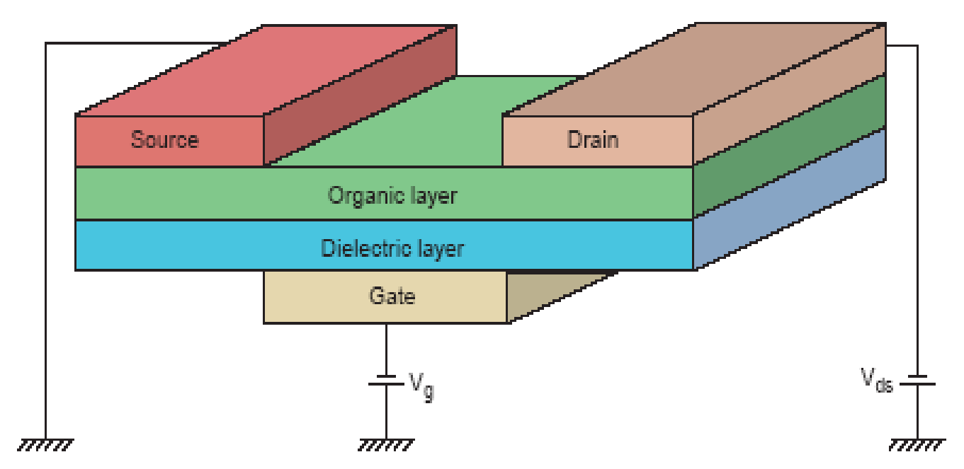
Structure of OTFT
–Organic Active Layer
Figure 6: structure of OTFT

Slide 20
Structure of OTFT
Very Similar to MOSFETs.
3-Terminal Device.
Voltage Controlled Switch.
Differences
–Carrier Transport
Discrete Energy Levels
Hopping
Depletion Devices
Organic Active Layer

Slide 21
Application of organic TFT
OLED Device
OLED Display
Liquid Crystal Device
Plastic TFT LCD
Organic Thin Film
Transistor
E-paper, E-book
E-ink
Antenna
Contactless Smart Card
Materials Integration Technology
Wearable Computer

Slide 22
Advantages v/s disadvantages of polymer electronics
ADVANTAGES
Manufacture is relative simple and inexpensive equipment at low cost.
Light weighted and flexible, very durable under stress and flex can be easily applied over a large surface area.
Freedom of choice of their chemical composition
Adaptable in various ways because of printing methods that can be adjusted to current requirements quickly (printed electronics)

Slide 23
Advantages v/s disadvantages of polymer electronics
DISADVANTAGES
Due to their intrinsic physical properties (i.e. limited mobility of charge carriers), the performance of polymer electronic products lacks the speed of its silicon counterpart.
Research is still on going to increase performance for more complex functionality.
To be able to improve performance one should be able to distinguish between problems introduced during preparation, intrinsic material properties, and18device characteristics

Slide 24
Application
Fabrication of organic thin film transistors.
Non-volatile memory devices based on organic transistors.
Development of novel conjugated polymers for photovoltaic device applications.
Fabrication of organic photovoltaic cells.
Fabrication of organic light-emitting devices (OLED).
Printed Electronics.
Conducting Polymer Actuators and Micropumps.
Focused upon polymer membranes that incorporated electronically conducting polymers and piezoelectric polymers.

Slide 25
Conclusions
ICPs are Electrically-conductive polymers in which the Conductivity arises from the presence of conjugated car-bon-carbon bonds. These conjugated polymers possess interesting and useful properties due to their delocalised electron systems.
Polymer electronics are light, flexible, and less expensive to produce on a mass quantity scale than conventional electronics.Polymer electronics are not a competing product but are considered to be more complementary to its silicon counterpart.
19

Slide 26
References
Balde J. W. (Ed.), "Foldable Flex and Thinned Silicon Multichip Packaging Technology", Kluwer Academic-Publishers for IMAPS (Norwell, 2002) pp. 106-114
Landesberger C. et al., "New Dicing and Thinning Concept Improves Mechanical Reliability of Ultra Thin Silicon," Proc IEEE 01TH8562, ISBN 0-930815-64-5, March 2001, pp. 92-97
Notes:
B-TECH PROJECT MID-SEM PRESENTATION 2011
BY KHUSHBU KHAN & ISAN SAHOO
26

Slide 27
THANK YOU

